Slide 1
Mead Temperatures

Slide 2
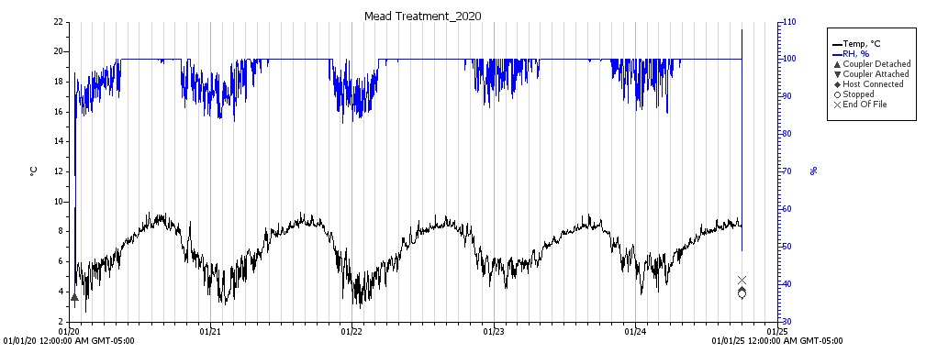
Wall

Slide 3
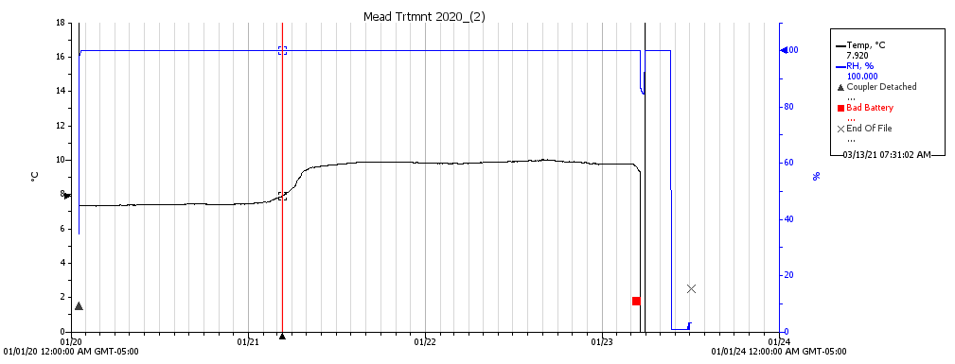
200 feet in

Slide 4
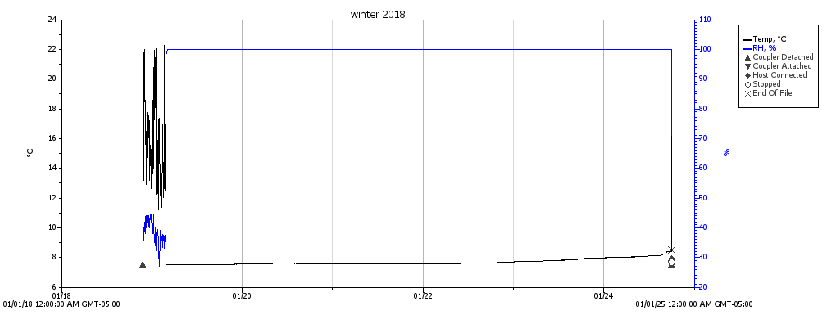
Back of Mine

